Slide 1

Automated Design Team
AUTOCAD TEAM
ALISSA DIMINICH
NICOLE GUMBS
SARAH STODTER

Slide 2
Goals - Nicole
Documentation
  Tank
  Sludge Pipe
  Manifold
  Sedimentation Tank Slopes
  Chemical Stock Tank
  Basics
  Lamina
Other Tasks
  Eclipse SVN
  Transparent AguaClara Logo

Slide 3
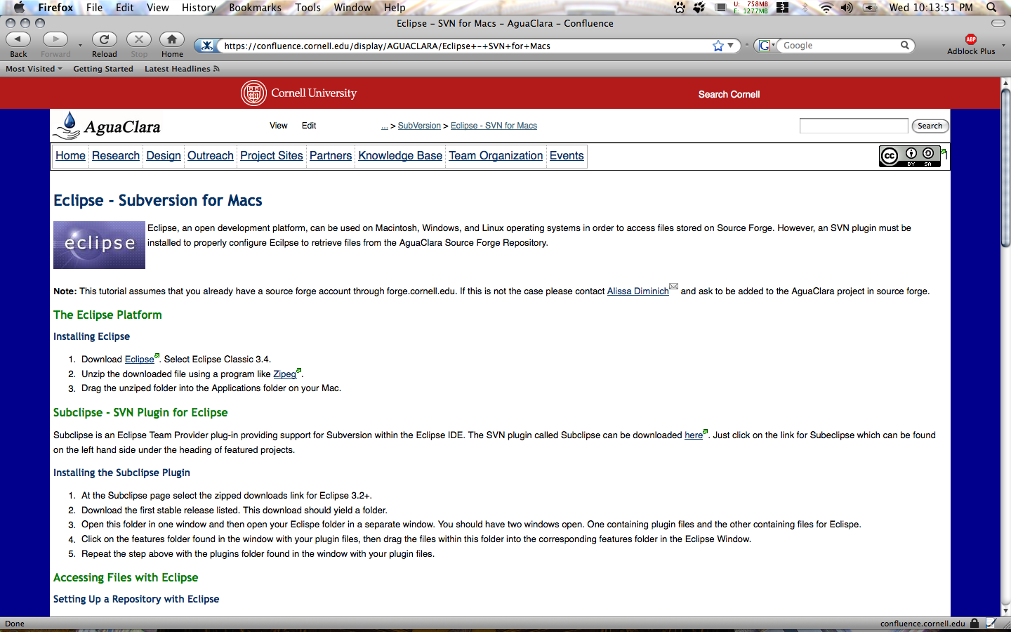
Eclipse SVN - SubEclipse

Slide 4
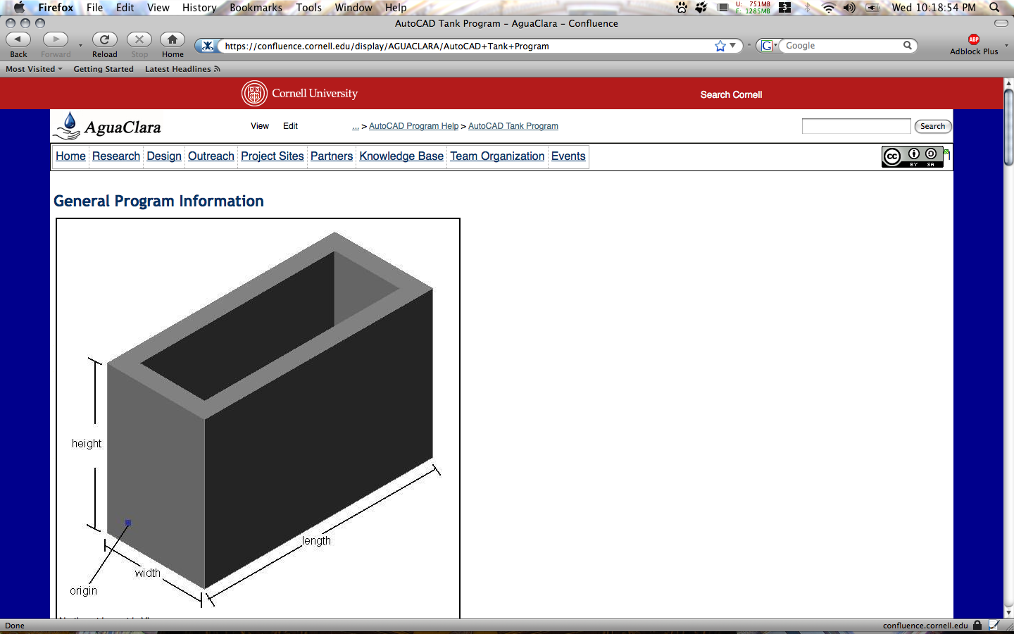
AutoCAD Tank Program

Slide 5
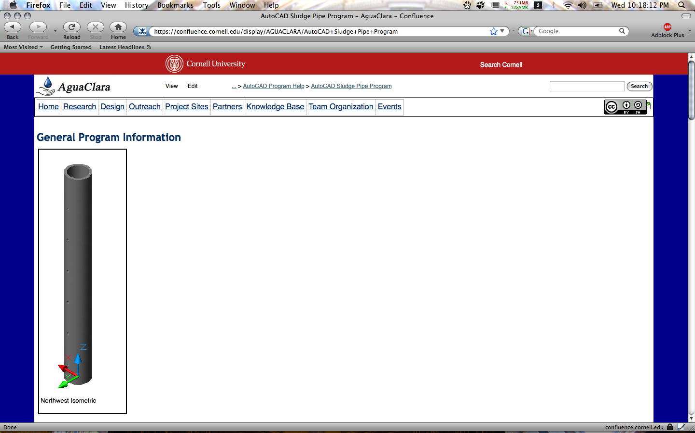
AutoCAD Sludge Pipe Program

Slide 6
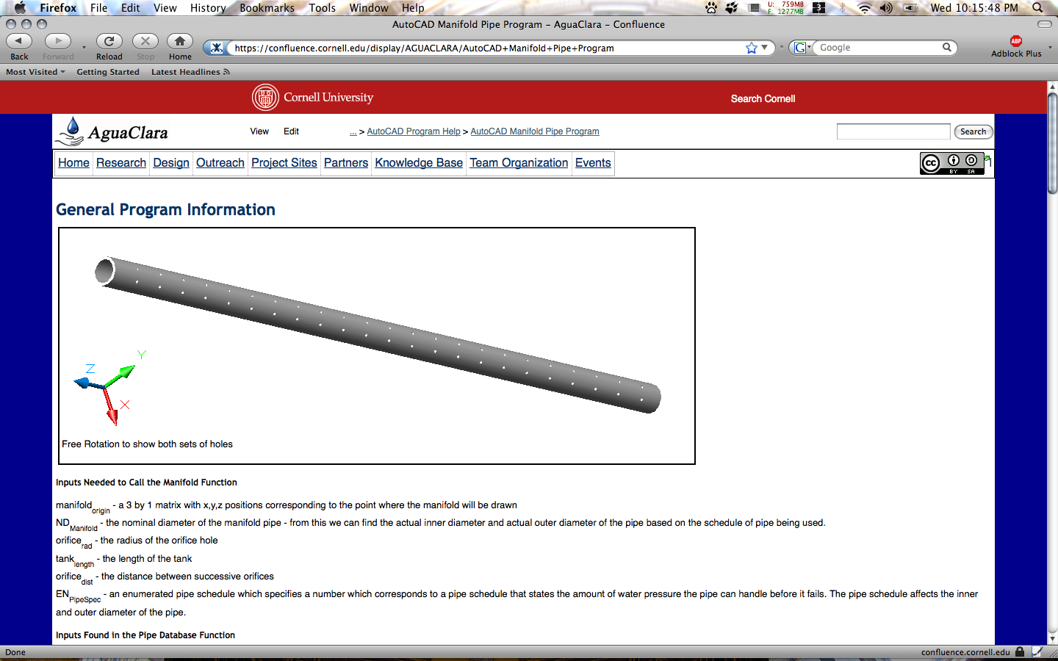
AutoCAD Manifold Program

Slide 7
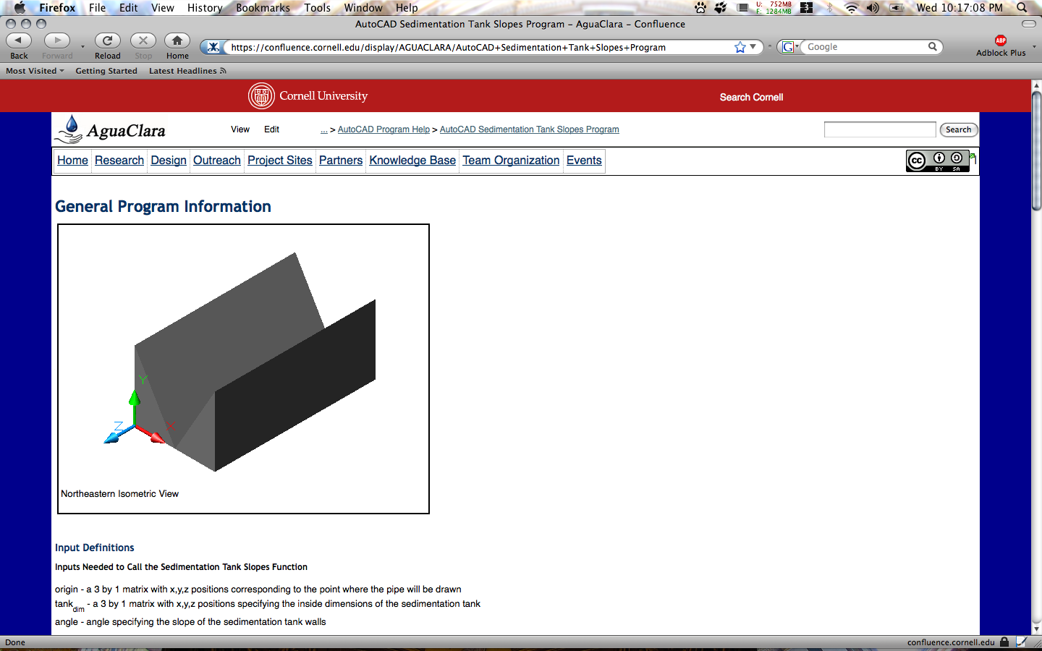
AutoCAD Sedimentation Tank Slopes Program

Slide 8
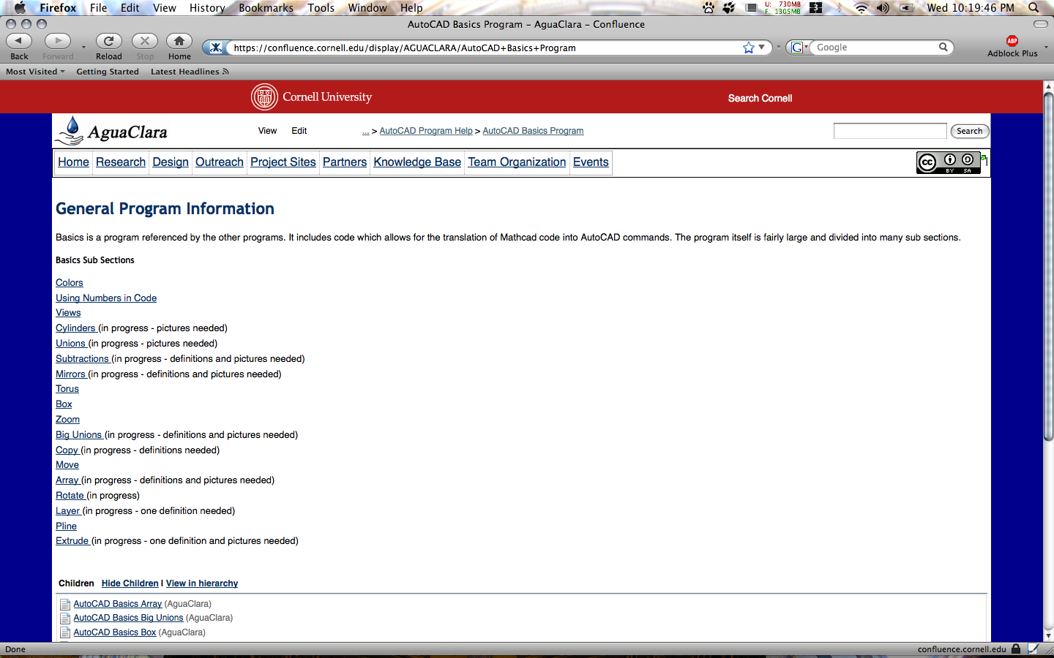
AutoCAD Basics Program

Slide 9
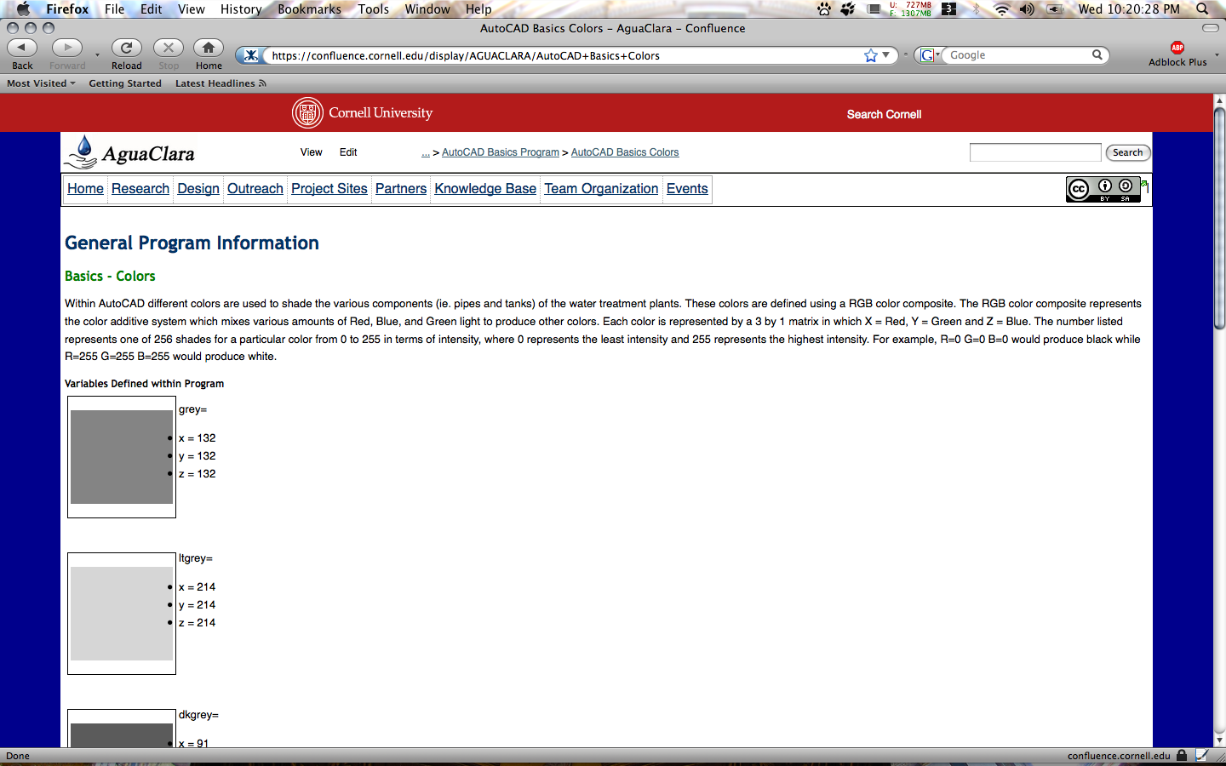
AutoCAD Basics Colors Program

Slide 10
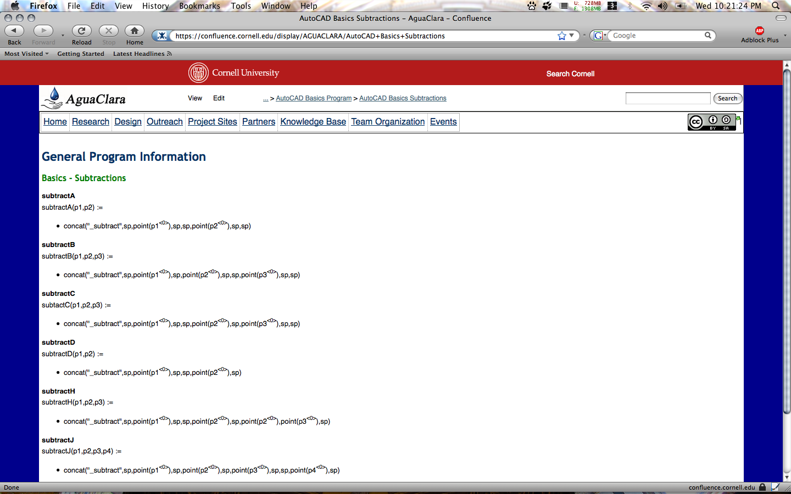
AutoCAD Basics Subtractions Program

Slide 11
AguaClara Logo
Before
After

Slide 12
Future Work - Fall 2008
Explore other single and cross platform alternatives for accessing Source Forge files
Made detailed descriptions of what is needed to complete a specific documentation page
Documentation
  Chemical Stock Tank – 8 to 10 hrs
  Lamina - 15 hrs
  Basics - 10 to 15 hrs

